Slide 1

CSE (H) with specialization in Machine Learning and Artificial Intelligence
Soft Computing (CSF – 332)
Chapter -1.3
Neural Network Types
By: Dr. Monika Singh E11032
DISCOVER . LEARN . EMPOWER

Slide 2
Course Objectives
To introduce soft computing concepts and techniques of artificial neural networks, fuzzy sets, fuzzy logic and genetic algorithms
To understand the various techniques from the application point of view.
To analyze various soft computing techniques and decide the technique to be used in a particular problem situation.
To implement soft computing based solutions for real-world problems

Slide 3
Course Outcomes
CO1 | Identify and describe soft computing techniques and their roles in building intelligent. Machines | 1
CO2 | Recognize the feasibility of applying a soft computing methodology for a particular problem. | 2,4
CO3 | Apply fuzzy logic and reasoning to handle uncertainty and solve engineering problems, genetic algorithms to combinatorial optimization problems and neural networks to pattern classification and regression problems. | 3
CO4 | Effectively use modern software tools to solve real problems using a soft computing approach. | 3
CO5 | Evaluate various soft computing approaches for a given problem. | 4

Slide 4
Table of Contents
Neural Network Types
Taxonomy of neural networks
Fully connected layer
Back Propagation

Slide 5
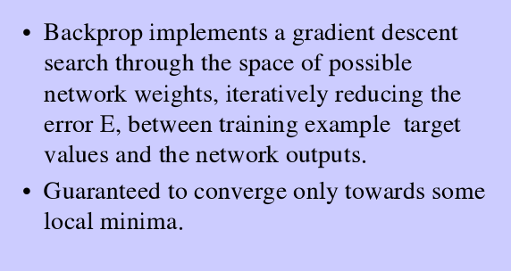
BACK PROPAGATION NETWORK

Slide 6
A training procedure which allows multilayer feed forward Neural Networks to be trained.
Can theoretically perform “any” input-output mapping.
Can learn to solve linearly inseparable problems.

Slide 7
MULTILAYER FEEDFORWARD NETWORK
Inputs
Hiddens
I₀
Outputs
h₀
I₁
o₀
h₁
I₂
o₁
h₂
Outputs
I₃
Hiddens
Inputs
“Principles of Soft Computing, 3rd Edition”
by S.N. Sivanandam & SN Deepa
Copyright © 2019 Wiley India Pvt. Ltd. All rights reserved.

Slide 8
GRADIENT DESCENT
Gradient-Descent(training_examples, η)
Each training example is a pair of the form <(x₁,…x_{n}),t> where (x₁,…,x_{n}) is the vector of input values, and t is the target output value, η is the learning rate (e.g. 0.1)
Initialize each wi to some small random value
Until the termination condition is met, Do
Initialize each Δwi to zero
For each <(x₁,…x_{n}),t> in training_examples Do
“Principles of Soft Computing, 3rd Edition”
by S.N. Sivanandam & SN Deepa
Copyright © 2019 Wiley India Pvt. Ltd. All rights reserved.

Slide 9
Input the instance (x1,…,xn) to the linear unit and compute the output o
For each linear unit weight wi Do
Δw_{i}= Δw_{i} + η (t-o) xi
For each linear unit weight wi Do
w_{i}=w_{i}+Δw_{i}
“Principles of Soft Computing, 3rd Edition”
by S.N. Sivanandam & SN Deepa
Copyright © 2019 Wiley India Pvt. Ltd. All rights reserved.

Slide 10
MODES OF GRADIENT DESCENT
Batch mode : gradient descent
w=w - η ∇ED[w] over the entire data D
ED[w]=1/2Σd(t_{d}-o_{d})2
Incremental mode: gradient descent
w=w - η ∇E_{d}[w] over individual training examples d
Ed[w]=1/2 (t_{d}-o_{d})2
Incremental Gradient Descent can approximate Batch Gradient Descent arbitrarily closely if η is small enough.
“Principles of Soft Computing, 3rd Edition”
by S.N. Sivanandam & SN Deepa
Copyright © 2019 Wiley India Pvt. Ltd. All rights reserved.

Slide 11
BACKPROPAGATION TRAINING ALGORITHM
Initialize each wi to some small random value.
Until the termination condition is met, Do
For each training example <(x1,…xn),t> Do
Input the instance (x1,…,xn) to the network and compute the network outputs ok
For each output unit k
δk=ok(1-ok)(tk-ok)
For each hidden unit h
δh=oh(1-oh) Σk wh,k δk
For each network weight w,j Do
wi,j=wi,j+Δwi,j where
Δwi,j= η δj xi,j
“Principles of Soft Computing, 3rd Edition”
by S.N. Sivanandam & SN Deepa
Copyright © 2019 Wiley India Pvt. Ltd. All rights reserved.

Slide 12
BACKPROPAGATION
Gradient descent over entire network weight vector
Easily generalized to arbitrary directed graphs
Will find a local, not necessarily global error minimum -in practice often works well (can be invoked multiple times with different initial weights)
Often include weight momentum term
Δwi,j(t)= η δj xi,j + α Δwi,j (t-1)
Minimizes error training examples
Will it generalize well to unseen instances (over-fitting)?
Training can be slow typical 1000-10000 iterations (use Levenberg-Marquardt instead of gradient descent)
“Principles of Soft Computing, 3rd Edition”
by S.N. Sivanandam & SN Deepa
Copyright © 2019 Wiley India Pvt. Ltd. All rights reserved.

Slide 13
APPLICATIONS OF BACKPROPAGATION
NETWORK
Load forecasting problems in power systems.
Image processing.
Fault diagnosis and fault detection.
Gesture recognition, speech recognition.
Signature verification.
Bioinformatics.
Structural engineering design (civil).
“Principles of Soft Computing, 3rd Edition”
by S.N. Sivanandam & SN Deepa
Copyright © 2019 Wiley India Pvt. Ltd. All rights reserved.

Slide 14
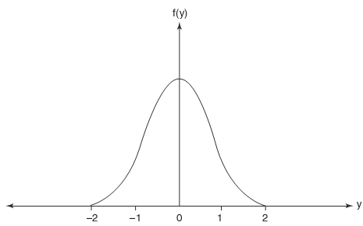

RADIAL BASIS FUCNTION NETWORK
The radial basis function (RBF) is a classification and functional approximation neural network developed by M.J.D. Powell.
The network uses the most common nonlinearities such as sigmoidal and Gaussian kernel functions.
The Gaussian functions are also used in regularization networks.
The Gaussian function is generally defined as
“Principles of Soft Computing, 3rd Edition”
by S.N. Sivanandam & SN Deepa
Copyright © 2019 Wiley India Pvt. Ltd. All rights reserved.

Slide 15
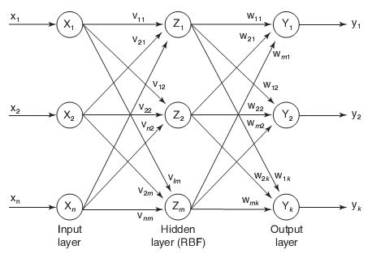
RADIAL BASIS FUCNTION NETWORK
“Principles of Soft Computing, 3rd Edition”
by S.N. Sivanandam & SN Deepa
Copyright © 2019 Wiley India Pvt. Ltd. All rights reserved.
“Principles of Soft Computing, 2nd Edition”
by S.N. Sivanandam & SN Deepa
Copyright © 2011 Wiley India Pvt. Ltd. All rights reserved.

Slide 16
Questions?
Q1. What are the applications of Back propagation algorithm?
Q2. How backpropagation is related to gradient descent?

Slide 17
References
Book:
S.N.Sivanandam, S.N Deepa, “Principles of Soft Computing”
Research Paper:
http://www.andrew.cmu.edu/user/nwolfe/esr/pdf/backprop.pdf
Websites:
https://nptel.ac.in/courses/106/105/106105173/
Videos:
https://towardsdatascience.com/laymans-introduction-to-backpropagation-efa2c64437db

Slide 18
THANK YOU
For queries
Email: monika.e11032@cumail.in

